Slide 1

Searching Through the Hierarchy: Modeling Categorical Search using Class-Consistent Features
Justin t maxfield, chen-ping yu, & Gregory J Zelinsky
Notes:
Hello. My name is Justin Maxfield and I’ll be speaking today about a generative model of categorical representations. We do this by formalizing the principles of within-category similarity and between-category distinctiveness. Before I get into the specifics, we should address the big picture. Categories make us who we are. It is our knowledge of them and the application of that knowledge that allows us to navigate a world that would otherwise be filled with novel objects that would be incomprehensible.

Slide 2
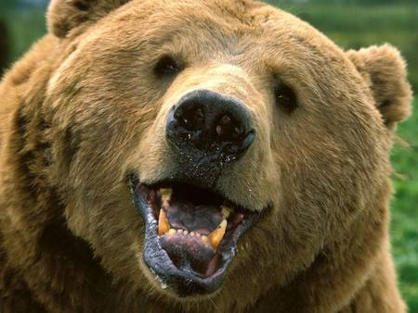
The Big Picture
Run?
Fight?
Pet?
Notes:
For example, based on our prior experience, we can make an informed decision about what to do if we come across a bear. Running may seem the prudent choice for most of us while others may choose to fight in hopes of scaring the bear off. If we’re a zookeeper on the other hand, we may just give them a friendly pet. How do we learn these categories? How are they organized in our memories? How flexible are they? These are the sorts of questions researchers have been asking for decades. And while psychologists have made great strides in addressing these issues, there is one way in which we are severely limited.

Slide 3
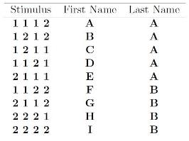
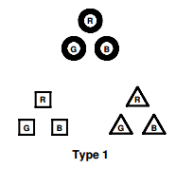
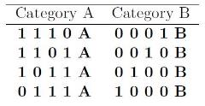
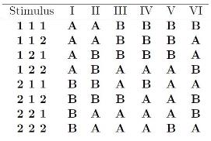
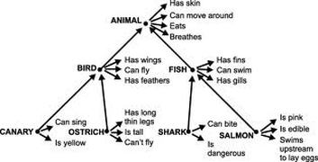
The Big Picture
Yamauchi et al. (2002)
Medin et al. (1983)
Lee & Navarro (2002)
Collins & Quillian (1969)
Shephard et al. (1961)
Notes:
These are categories. Rather, these are some of the logical structures used to test category learning models. Simple stimuli are coded based on their perceptual dimensions such as color, size, form, and position. However, these values are often only binary, which allows for precise control but suffers from a limited feature space. A common approach is to design discriminative models to accurately approximate learning categories. However it is more difficult to understand how we categorize objects when the features aren’t as simple. This is where generative models could prove useful. They are able to examine the whole picture.

Slide 4
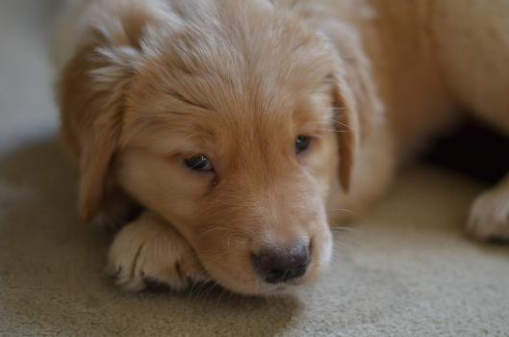
Hierarchical Levels
Mammal
Superordinate
Dog
Basic
Subordinate
Golden
Retriever
Notes:
Almost any object we can think of can be categorized as belonging to numerous categories which can be organized in a hierarchical structure. For instance, this object; We can be very specific and call it a Golden Retreiver; be somewhat vague and describe it as a mammal; or at an intermediate level, such as a dog. It’s this basic level that has garnered an impressive amount of research and has been shown to typically be the fastest level that we categorize objects at. What are some ways that we use our knowledge of categories?

Slide 5



Search Procedure
Vehicle
Plane
+
Passenger Airliner
Search Display (guidance epoch)
Search Display (verification epoch)
2500 ms
500 ms
Notes:
One of our most common everyday tasks is to seek out and find an object in the environment around us. While it’s almost never the case that we are shown a picture of the object we’re about to look for, it’s much more common we only have the category to guide us. We first collected behavioral data from participants searching for an object, given only the name of the category as a cue. For the same target, they were cued at either a superordinate, basic, or a subordinate categorical level. We divided our analyses into two separate epochs of initial guidance to the target and verification of the target as a category member. The guidance epoch was operationalized as the time from the start of the trial until they first fixated on the target while verification was from when they first fixated on the target until they made a present or absent button press decision.

Slide 6
Time to Target
Notes:
The overall times of the guidance epoch showed a subordinate level advantage. So when participants were cued with a more specific categorical cue, they were able to guide their attention to the target significantly faster than when cued at the basic level, which was in turn significantly faster than cues at the superordinate level.

Slide 7
Target Fixated First
Notes:
This pattern is also seen in another measure of guidance, the proportion of trials in which the target was the first object fixated. Here we see the same significant linear trend, demonstrating a subordinate level advantage in search guidance.

Slide 8
Verification Time
Notes:
However, in verification times we see a very different pattern. From the time when they fixated on the target until they button press, there is a basic level advantage, replicating the work first done by Rosch and colleagues and replicated by many others. These findings are in line with our previous work on categorical search, showing a subordinate level advantage for guidance and that there is a verification task that is nested within the search process where the basic level is fastest.

Slide 9
Specificity & Distinctiveness
Subordinate level:
Very Specific
Not Distinctive
Basic Level:
Somewhat Specific
Somewhat Distinctive
Superordinate Level:
Not at all specific
Very Distinctive
Notes:
This advantage for verification at the basic level is thought to stem from its intermediate tendencies in terms of specificity and distinctiveness. It has enough specific features to be recognizable and is dissimilar enough to other nearby categories to be distinct. The subordinate and superordinate levels on the other hand have more extreme leanings. Subordinate categories have very specific features but also a lot of similar neighboring categories while superordinate categories are generally very distinct but lack a lot of features in common between all of its members.

Slide 10
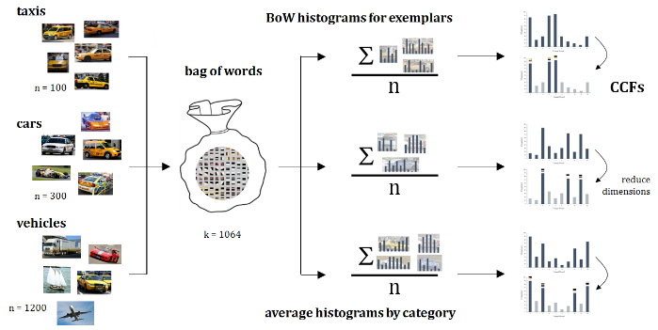
Category-Consistent Feature Model
Notes:
By formalizing these two core principles of specificity and distinctiveness, our goal is create a generative model that is able to learn the representations of categories. Computational models serve as an explicit baseline from which to make predictions and form theories. The main focus of our model is create a straightforward method of capturing the important features of any given category of objects, using high dimensional features that will work with images of objects. This is an overview of our model which I will walk through now.

Slide 11
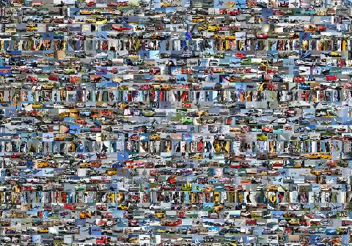
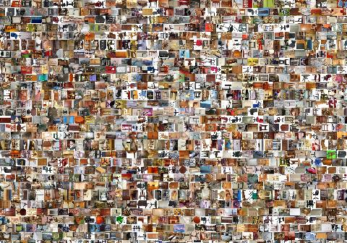
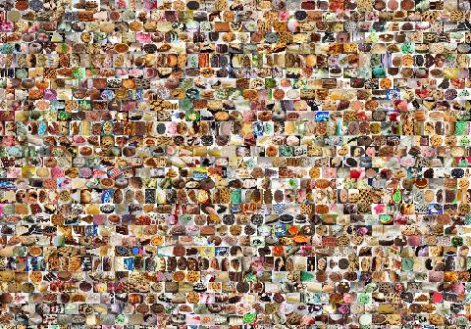

Notes:
In order to address the big picture, we decided to use a lot of smaller pictures. Our stimulus set was 4,800 cropped objects collected from ImageNet and Google. These images were split equally between 4 superordinate categories: Vehicles, Furniture, Desserts, and Clothing with each of these split into 4 basic level categories each,

Slide 12
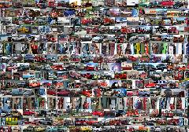
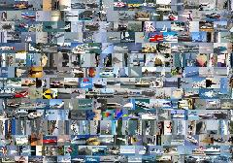
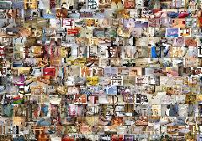
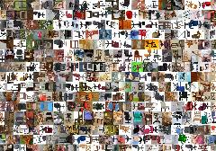
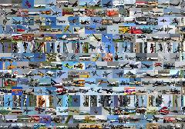
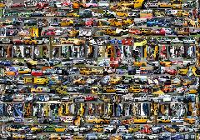
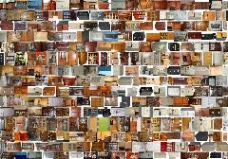
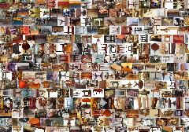
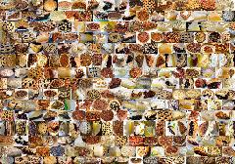
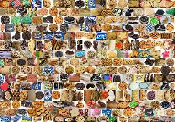
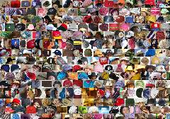
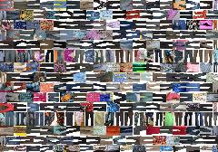
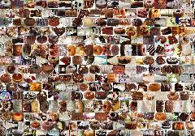
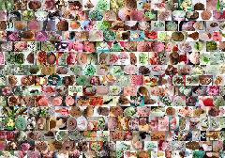
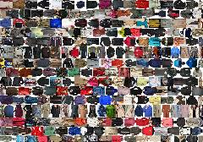
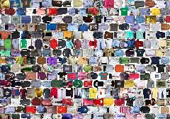
Notes:
with each of those split into 3 subordinate level categories each.

Slide 13
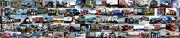



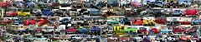

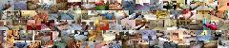
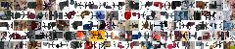
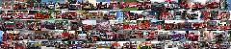

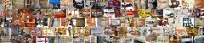
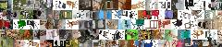
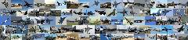

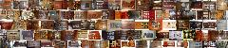



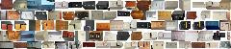


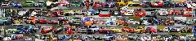





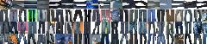
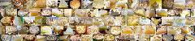
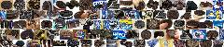
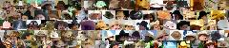
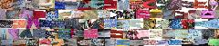
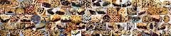
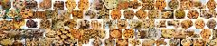


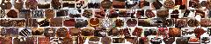

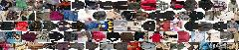
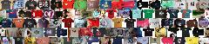
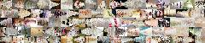
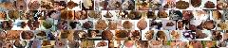






Notes:
This hierarchical structure is the same as we used in the behavioral experiment. If you think you’re starting to see some similarities within and between these categories, even from this broad overview, you’re picking up on one of the biggest reasons we decided to create a generative model. By examining lots of positive samples, a generative model can learn these sorts of distinctions on its own, much like the countless exposures to objects that we see and categorize without a second thought.

Slide 14

Taxis
Cars
Vehicles
Notes:
To make this process a bit clearer, lets focus on an example category from each level: taxi, car, and vehicle. We started by extracting the features from every single exemplar. We did this by using Scale-Invariant Feature Transform, or SIFT, along with hue features.

Slide 15


Category-Consistent Features
Bag-of-Words Method
visual words in dictionary
Step 1: Extract features and create a visual dictionary
00
bag-of-words
histogram
Step 2: Create descriptors in this common feature space for
individual exemplars
Figure adapted from Bandara (2014)
Notes:
To make all the histograms comparable in the same feature space we used the Bag-of-Words method to create a dictionary of visual words, which is basically a high-dimensional feature space where the features of each image are clustered into a certain number of areas. We chose to designate 1000 SIFT words and 64 hue words so that each exemplar was now represented as a 1064 feature histogram. I’m not going to spend too much time on the details of how this feature extraction works. If you saw my advisor, Greg Zelinsky’s symposium talk yesterday, he covered this briefly.

Slide 16
Taxis
Cars
Vehicles
Notes:
The important thing to understand at this point is that we have a histogram of features for each exemplar all in one common space.

Slide 17

Taxis
Cars
Vehicles
Notes:
.gif

Slide 18

Histogram Visualization
Taxis
100
Exemplars
1
1
Visual Words
1064
Cars
300
Exemplars
1
1
Visual Words
1064
Notes:
Let’s take a look at another way we can visualize these histograms. Here you can see a rectangle where each row represents the histogram of one exemplar and each column represents one bin of a visual word. Black areas indicate that for that exemplar, there were little to no features found in that cluster. Brighter areas mean that there was a higher frequency of features. Already starting to emerge, you can begin to see some patterns, albeit noisy. There are some vertical lines where there is some consistency between these exemplars. Our model is essentially one of dimensionality reduction. We want to get rid of the unimportant noise in the features of these categories and only find the important consistent ones. For the car example here, you can see much of the same: there are some definite commonalities between the exemplars of this category, but there’s also a lot of noise.

Slide 19
Histogram Visualization
Taxis
100
Exemplars
1
1
Visual Words
1064
Cars
300
Exemplars
1
1
Visual Words
1064
Notes:
Let’s take a look at another way we can visualize these histograms. Here you can see a rectangle where each row represents the histogram of one exemplar and each column represents one bin of a visual word. Black areas indicate that for that exemplar, there were little to no features found in that cluster. Brighter areas mean that there was a higher frequency of features. Already starting to emerge, you can begin to see some patterns, albeit noisy. There are some vertical lines where there is some consistency between these exemplars. Our model is essentially one of dimensionality reduction. We want to get rid of the unimportant noise in the features of these categories and only find the important consistent ones. For the car example here, you can see much of the same: there are some definite commonalities between the exemplars of this category, but there’s also a lot of noise.

Slide 20
Histogram Visualization
Taxis
100
Exemplars
1
1
Visual Words
1064
Cars
300
Exemplars
1
1
Visual Words
1064
Notes:
Let’s take a look at another way we can visualize these histograms. Here you can see a rectangle where each row represents the histogram of one exemplar and each column represents one bin of a visual word. Black areas indicate that for that exemplar, there were little to no features found in that cluster. Brighter areas mean that there was a higher frequency of features. Already starting to emerge, you can begin to see some patterns, albeit noisy. There are some vertical lines where there is some consistency between these exemplars. Our model is essentially one of dimensionality reduction. We want to get rid of the unimportant noise in the features of these categories and only find the important consistent ones. For the car example here, you can see much of the same: there are some definite commonalities between the exemplars of this category, but there’s also a lot of noise.

Slide 21
Histogram Visualization
Taxis
100
Exemplars
1
1
Visual Words
1064
Cars
300
Exemplars
1
1
Visual Words
1064
Notes:
Let’s take a look at another way we can visualize these histograms. Here you can see a rectangle where each row represents the histogram of one exemplar and each column represents one bin of a visual word. Black areas indicate that for that exemplar, there were little to no features found in that cluster. Brighter areas mean that there was a higher frequency of features. Already starting to emerge, you can begin to see some patterns, albeit noisy. There are some vertical lines where there is some consistency between these exemplars. Our model is essentially one of dimensionality reduction. We want to get rid of the unimportant noise in the features of these categories and only find the important consistent ones. For the car example here, you can see much of the same: there are some definite commonalities between the exemplars of this category, but there’s also a lot of noise.

Slide 22

Taxis
Cars
Vehicles

Slide 23

Taxis
Cars
Vehicles
Notes:
Going back to our example category, we averaged each word for all of the histograms within a category to create one averaged bag of words histogram.

Slide 24

Taxis
Cars
Vehicles
Notes:
You can think of this as a prototype if you’d like, but I’m going to avoid the term as it’s a bit theoretically laden. The crucial aspect of this averaged histogram is that each word now has a mean and standard deviation associated with it, which we will use to find the consistent features within a category.

Slide 25

Taxis

Slide 26

Taxis
Notes:
Let’s focus on our Taxi category. We wanted to isolate features that appeared frequently and consistently across all members of the category. We did this using a two step process. The first was to use the interquartile range rule to select a set of candidates. From this candidate pool we computed the inverse of its coefficient of variation by dividing its mean frequency by its standard deviation. This is a common method for quantifying a scale-invariant signal-to-noise ratio. This gave each candidate CCF a weight where higher values indicated a higher likeliehood of being an important feature.

Slide 27

Taxis
Category-Consistent Features
Inverse Coefficient of Variation
Interquartile Range Rule
Notes:
The words that remained, highlighted here in red, are what we call Category Consistent Features, or CCF’s. These CCF’s can be thought of as the learned visual representation of an object category.

Slide 28
Histogram Visualization
Taxis
Taxi CCFs
Notes:
Going back to our histogram visualization, you can the CCFs we selected match well with the consistencies of the exemplars while pruning away the noise. The brightness of the CCFs shows the relative weight for each feature, with features with higher means and lower standard deviations being the brightest.

Slide 29
Number of CCFs = Specificity
Number of CCFs was highest at the subordinate level, approximating the specific within category similarity
What about between category distinctiveness?
Number of CCFs
Notes:
By looking at the number of CCFs by level, we see that there are the most consistent features at the subordinate level, followed by the basic and superordinate levels. In a little bit, I will show how this measure can be useful in predicting the within-category similarity that is thought to be driving the behavioral guidance data. Specificity is only one piece of the puzzle though to understanding categorical representations. To get the other piece we need to have a measure of between category distinctiveness. It makes sense that the closer two categories are to each other, the harder the verification judgement will be.

Slide 30











Sibling Distance = Distinctiveness
cars
boats
police car
race car
sailboat
Notes:
Our model quantifies the distinctiveness between categories by calculating what we are calling sibling distance. To briefly summarize the process, we take the chi-squared distance between the CCF histogram of category A and compare that to the corresponding bins of the feature histograms for all the exemplars in category A and category B. By averaging these hundreds of comparisons, we are able to quantify the distance between the important features of each category. We computed this distance for all categories that shared a parent.

Slide 31
Specificity & Distinctiveness
Subordinate level:
Very Specific
Not Distinctive
Basic Level:
Somewhat Specific
Somewhat Distinctive
Superordinate Level:
Not at all specific
Very Distinctive
Number of CCFs
Mean Sibling Distance
Notes:
Adding this measure onto the secondary y-axis, we can clearly see the opposite trend here. There is less distance between the siblings at the subordinate level, which would contribute, along with high specificity to make verifying subordinate level categories more difficult. Overall, this pattern fits with the longstanding notions of within category similarity and between category distinctiveness. But did it fit our data?

Slide 32
Model Performance – Guidance(# CCF)
Notes:
In a word, yes. As I said before, the number of CCFs should correspond to the specificity of the target template used to guide search and indeed they do, falling within the 95% confidence intervals. We performed a linear transformation on the number of CCFs to put the model output into the same scale as Immediate Target Fixations and simply divided 1 over the number of CCFs to show the fit with Time to Target.

Slide 33
Model Performance – Verification (# CCF * Distance)
Notes:
The simplest way to combine the idea of specificity and distinctiveness in our model was to multiply the number of CCFs by the sibling distance for each category. Again we see a very strong fit from our model after a linear transformation. We checked our model rigorously to ensure its validity and that in fact the measures of specificity and sibling distance that we were deriving were useful above and beyond what could be found by chance. One such check was assuming we selected random words from the histogram instead of CCFs to compute sibling distance. This is a strong control in that there are many differences between all the histograms that we are using, and these differences could possibly account for the whole pattern that we are finding.

Slide 34
Model Performance – Verification (# CCF * Distance)
Notes:
Fortunately that was not the case as we can see here. The basic level is still the lowest, but after that, the pattern falls apart.

Slide 35
Applications & Direction
Animal
Dog
Mallard
Pekin
Husky
Pug
Duck

Slide 36





Summary
$$=$$
Notes:
To conclude, categories are complex! But we have new tools to explain old ideas. It’s possible to scale up our understanding of how categories are represented and used in order to take a step closer to the real world. We were able to create a generative model that takes images of objects as input and dimensionally reduce their features from a high level space into a categorical representation that can be used to predict behavioral performance in a search task.

Slide 37

Acknowledgments
Eye Cog lab
Chen Ping Yu and Greg Zelinsky
Hossein Adeli & Eye Cog Lab RA’s
NSF Grants IIS-1111047 & IIS-1161876
Notes:
I’d like to acknowledge my co-authors, the rest of the eye cog lab and my funding sources. Thank you and at this point I’d be happy to answer any questions you may have.

